Slide 1

A Project Seminar
On
“COMPENSATION OF VOLTAGE SWELL
BY USING FACTS DEVICE”
Guided by
PROF. ABHIJIT SINGARE
Presented by
SURAJ D. BAGEKAR SAMYAK M. NARANJE
DHARATI B. RAUT DHANANJAY U. WAKE
SHAHRUKH H. KHAN VIDYA V. MALYALWAR
Department of Electrical Engineering
2017-18
DATTA MEGHE INSTITUTE OF ENGINEERING TECHNOLOGY AND RESEARCH, SAWANGI(Meghe), WARDHA

Slide 2
CONTENTS
Introduction
Problem Statement
Literature Survey
Aim & Objective of Project
Workdone
Proposed Work
7. Reference

Slide 3
INTRODUCTION
In power system, power quality is one of the important aspect as power quality problems are occurred due to occurrence of voltage swell, voltage sag, transient, harmonics distortion, etc. in the transmission line. Out of these, voltage swell has less predominantly occurred and creates severe impact on transmission line and sensitive devices connected to it.
By IEEE 1159 Voltage swell is an increase in RMS voltage level from 110% to 180% of nominal voltage at power frequency for the duration of 1/2 cycle to 1 minute. The voltage swell is occurred due to de-energising of large heavy loads, switching of load, etc. The occurrence of voltage swell is very low but when it is occurred it creates severe impact on transmission line and connected devices. Hence it is necessary to mitigate or compensate the voltage swell to improve power quality of transmission line. The compensation of voltage swell is done by using FACTS device ( STATCOM ).
The project scheme for analysis is make on MATLAB software for 132kv transmission line without including STATCOM and with including STATCOM. Which shows that voltage swell has been compensated and voltage profile has been improved.

Slide 4
PROBLEM STATEMENT:
The voltage swell is occurred due to sudden switching of heavy load.
The voltage swell introduced the power quality problem.
The increase in system voltage may damage the equipment connected to it.
It creates economical problem.

Slide 5
LITERATURE REVIEW
1. Multilevel D-statcom for voltage sag and swell mitigation using modulation index control.
In this paper, D-statcom has been utilised to regulate voltage to its nominal value by exchanging reactive power with distribution load.
2. Performance comparison of PI and ANN based STATCOM for 132KV transmission line.
This paper presents simulation model of the 132KV transmission line with comparison of ANN based STATCOM and conventional based STATCOM.
Simulation of custom power electronic device D-STATCOM-A case study.
In this paper D-STATCOM is proposed for compensation of
reactive power and unbalance caused by various load in distribution
system.

Slide 6
AIM & OBJECTIVE OF PROJECT
AIM: Compensation of voltage swell by using FACTS device(STATCOM).
OBJECTIVE: Improving the voltage profile by compensating the voltage swell.

Slide 7

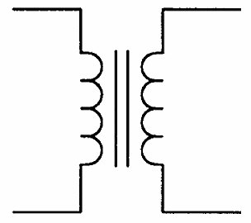

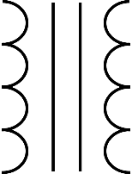
WORKDONE:
1. BLOCK DIAGRAM OF STATCOM
132KV Transmission line
11kv Industrial
Load
Connector
switch
132kv
source
132/11kv
transformer
STATCOM
CONTROL SYSTEM
VSC
c

Slide 8
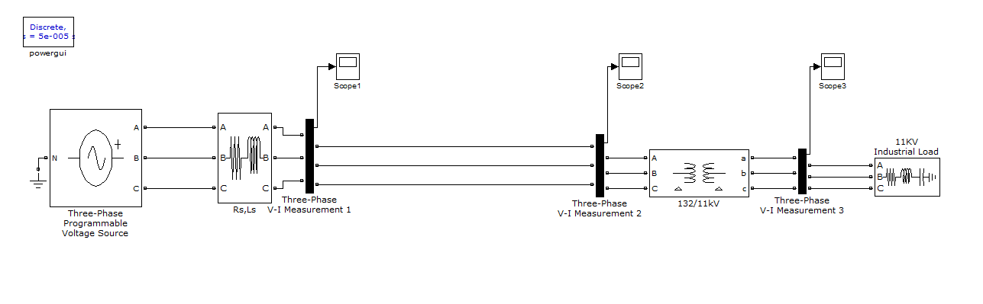
2. 132kV TRANSMISSION LINE MODEL

Slide 9
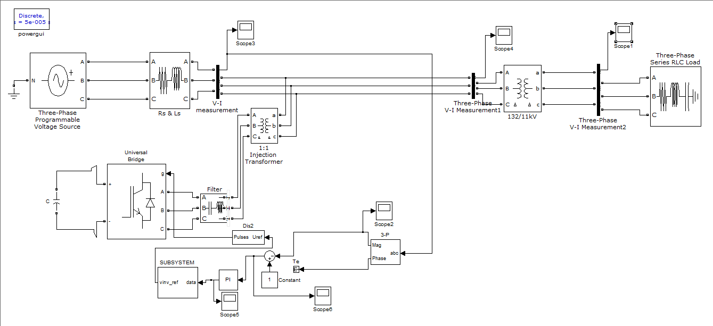
3. TRANSMISSION LINE WITH STATCOM

Slide 10
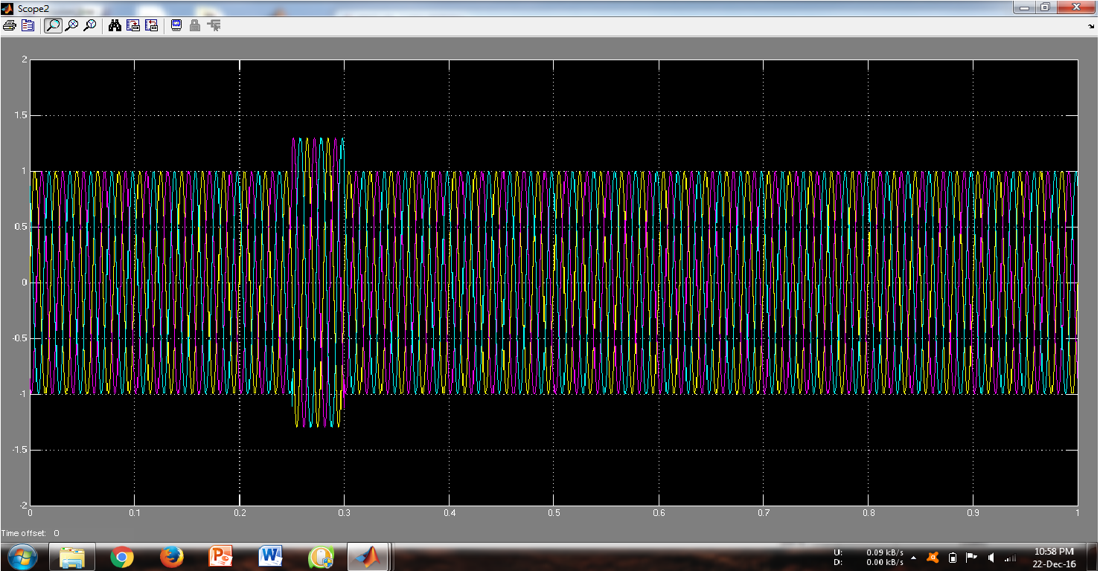
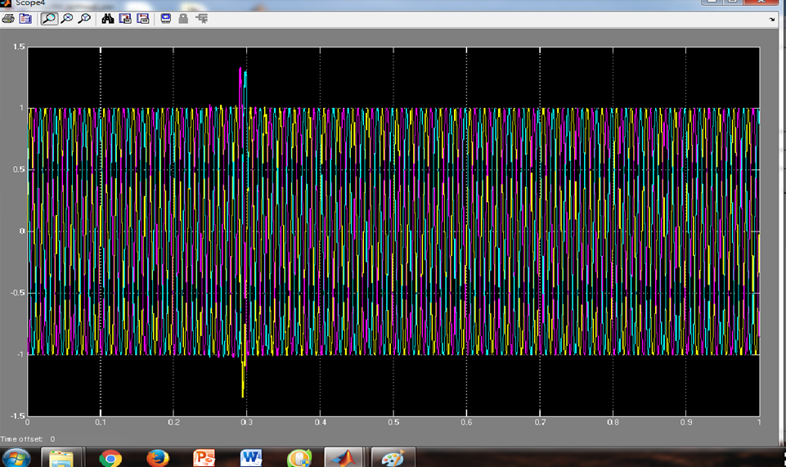
GRAPHS OF UNCOMPENSATED :
GRAPHS OF COMPENSATED:

Slide 11
PROPOSED WORK
Sr. No. | Project Work
1 | Initially, we understood the transmission line, STATCOM and its control techniques then we made block diagram of system. Then we made simulation of simple transmission line and created the swell on it and observe the result.
2. | Then after we made a simulation of transmission line with STATCOM and observe the output voltage waveform.
3. | In the output waveform, the complete swell is not compensated i.e. some amount of swell in voltage waveform is present in it even the STATCOM has been connected to transmission line.

Slide 12
REFERENCE PAPERS
BOOKS [II] N.G.Hingorani, L. Gyugyi, Understanding FACTS, Concepts and Technology of Flexible AC Transmission systems, IEEE Press 2000.
K.R.Padiyar, FACTS Controllers in power Transmission and distribution. New age international publishers, first edition 2007.
DeDad, John A., EC&M, "Power Quality and electronic equipment protection.. What to Use, When to Use it", January, 1991, pg 37-46.
Dorr, Douglas S. National Power Laboratory Power Quality Study, "Point of Utilization Power Quality Study Results, October 1994.
Douglas, John, EPRI Journal, "Power Quality", December 1993, pg 8-15. CEE News, March 12, 1994.
K.R. Padiyar “FACTS controllers in power transmission and distribution“new age international(p) limited, publishers.
B. Singh and J. Solanki, “A Comparison of Control Algorithms for DSTATCOM” IEEE TRANSACTIONS ON INDUSTRIAL ELECTRONICS, VOL. 56, NO. 7, JULY 2009.
B.-S. Chen and Y.-Y. Hsu, “A minimal harmonic controller for a STATCOM,” IEEE Trans. Ind. Electron., vol. 55, no. 2, pp. 655–664, Feb. 2008.
Ben-Sheng Chen and Yuan-Yih Hsu," An Analytical Approach to Harmonic Analysis and Controller Design of a ST A TCOM", IEEE Trans. Power Delivery, Vol. 22, No. I, Jan 2007.
T. Manokaran, B.Sakthivel and Mohamed Yousuf,"Cascaded Multilevel Inverter Based Harmonic Reduction in Statcom" International Journal of Engineering Science and Technology, Vol. 2(10), 2010.

Slide 13
THANK YOU

